Slide 1
Session 9: Marie Skłodowska-Curie Actions (MSCA)
HORIZON EUROPE

Slide 2
HORIZON EUROPE – SHORT OVERVIEW
Specific Programme implementing Horizon Europe & EIT*
Exclusive focus on civil applications
Pillar I
Excellent Science
Pillar II
Global Challenges & European Industrial Competitiveness
Pillar III
Innovative Europe
European Research Council
Health
Culture, Creativity & Inclusive Society
Civil Security for Society
Digital, Industry & Space
Climate, Energy & Mobility
Food, Bioeconomy, Natural Resources, Agriculture & Environment
European Innovation Council
Marie Skłodowska-Curie
Clusters
European Innovation Ecosystems
Research Infrastructures
European Institute of Innovation & Technology*
Joint Research Centre
Widening Participation and Strengthening the European Research Area
Widening participation & spreading excellence
Reforming & Enhancing the European R&I system

Slide 3
Overview of MSC Actions
Doctoral Networks (DN) Research training of doctoral candidates
Postdoctoral Fellowships (IF): Career development of Postdocs
Staff Exchanges (SE): Cooperation by means of staff exchange
Co-funding of regional, national and international programmes (COFUND): Co-Funding of Doctoral or Fellowship Programmes
MSCA and Citizens: Pan-European Researchers’ Night to promote research careers

Slide 4
MSCA: Basic Principles
Scientific excellence
Career development and innovative research training
Bottom-up approach
Transnational mobility is the key element
Open to hosts from academic and non-academic sector > career perspectives in academia AND industry
Training
MSCA
Career
Mobility
Notes:
The MSCA are aimed at fostering the career development of researchers at all career stages;
The MSCA pursue a bottom-up approach. This means that project proposals from all scientific fields may receive funding.
Crucial is solely their scientific excellence.
Besides the “scientific excellence” of research proposals, the second keyword you should retain is “mobility”.
The MSCA are the dedicated mobility programme within the first pillar in “Horizon Europe”.
The European Commission considers mobility as an asset for the career development of researchers.
That’s why the key participation requirement for the most of the Marie Skłodowska-Curie actions is undertaking mobility.
Talking about mobility we distinguish between: A. Physical transnational mobility: this means that researchers are required to go to another country in order to broaden their knowledge;
B. Intersectoral mobility: this type of mobility is about interaction between academia and business.
I have now mentioned two keywords to keep in mind when talking about the MSCA: “scientific excellence” and “mobility”.
The third keyword to remember is “employability”.
Exposure to academic and non-academic sectors is required in order to enhance the employability of researchers.
And this is another key element of the MSCA.

Slide 5
Detailed Information:
https://marie-sklodowska-curie-actions.ec.europa.eu/
Work Programme: https://ec.europa.eu/info/funding-tenders/opportunities/docs/2021-2027/horizon/wp-call/2023-2024/wp-2-msca-actions_horizon-2023-2024_en.pdf

Slide 6
MSCA Postdoctoral Fellowships (PF)
Career development of
Postdocs

Slide 7
General Information Postdoctoral Fellowships
Research areas: No pre-defined research topics (»bottom-up«)
Eligibility: Postdocs only: successfully defended doctoral thesis at the call deadline Scientific age: up to 8 years full-time equivalent experience in research after PhD career breaks (e.g. due to parental leave), will not be taken into account
Working conditions: Generally full-time employment contract including social security benefits
Application: researcher with the host institution active in Research & Development
Notes:
To be eligible to apply, you must be postdoctoral researchers at the date of the call deadline, i.e. in a possession of a doctoral degree, defined as a successfully defended doctoral thesis, even if the doctoral degree has yet to be awarded. A medical doctor degree will be accepted only when it corresponds to a doctoral degree or if the researcher can demonstrate his/her appointment in a position that requires doctoral equivalency (e.g. professorship appointment). Medical doctor degrees corresponding to basic medical training as defined in Annex V of Directive 2005/36/EC will not be considered a doctoral degree.
At the call deadline, supported researchers must have a maximum of 8 years full-time equivalent experience in research, measured from the date that the researcher was in a possession of a doctoral degree and certified by appropriate documents. Years of experience outside research and career breaks (e.g. due to parental leave), will not be taken into account. For nationals or long-term residents of EU Member States or Horizon Europe Associated Countries who wish to reintegrate to pursue their research career in EU Member States or Horizon Europe Associated Countries, years of experience in research in third countries will not be considered in the above maximum.
Maternity: for each child born prior to the call deadline, 18 months will be deducted from the experience in research unless the applicant can document a longer parental leave prior to the call deadline. Paternity: for each child born prior to the call deadline, the documented time of parental leave taken until the call deadline will be deducted from the experience in research.
For the duration of your fellowship you will be appointed under an employment contract including social security coverage;
You are expected to work full-time. Part-time work due to personal or family reasons can be requested; Part-time work due to engaging in supplementary activities (like creating a company, pursuing another research project, or engaging in advanced studies not related to your MSC grant); can be requested also, not for the outgoing phase of the Global Fellowships though.
You apply together with your chosen supervisor at the host institution. Your host institution will be the beneficiary of the Action and signs the Grant Agreement with the European Commission. This means that the host institution has the complete responsibility for the proper implementation of the action.

Slide 8
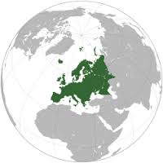
PF Programme Lines: an Overview
Global Fellowships
European Fellowships
Outgoing phase – 1-2 years
Incoming phase: 1- 2 years
Mandatory return phase – 1 year
Notes:
This is an overview of the different programme lines within the Individual Fellowships. You can see the different EF types with their respective duration on the left hand side and the GF on the right hand side.

Slide 9
Panels
Postdoctoral Fellowships will be evaluated in eight scientific panels:
Chemistry (CHE)
Social Sciences and Humanities (SOC)
Economic Sciences (ECO)
Information Science and Engineering (ENG)
Environment and Geosciences (ENV)
Life Sciences (LIF)
Mathematics (MAT)
Physics (PHY)
Notes:
European Standard Fellowships and Global Fellowships will be evaluated and ranked in eight scientific panels.
You can find a list of the scientific panels and their descriptors, which you will need to fill in form A of the application, in Annex 4 of the Guide for Applicants.
Multidisciplinary subpanels exist for Ri, CAR and SE. This means you still need the descriptors for the allocation of evaluators, but there will only be one ranking list for these 3 subpanels.

Slide 10
European Fellowship
1 to 2-year research stay in Europe (MS/AC) + optional additional placement in non-academic sector (MS/AC; max. 6 months)
Postdocs of any nationality (➜ mobility rule)
Host institution: must be active in Research & Development, e.g. university, research organisation, company (incl. SMEs), NGO, …
Submission and evaluation in eight scientific panels: CHE, SOC, ECO, ENG, ENV, LIF, MAT, PHY
Notes:
Within the Standard European Fellowship programme you conduct a 1 to 2-year research stay in Europe:
You must be an experienced researcher of any nationality;
But, keep in mind, that you have to comply with the general mobility rule;
Your host institution may be from any sector, but has to be active in Research & Development;
Your proposal is submitted and evaluated in eight scientific panels.

Slide 11
Global Fellowships
One to two-year research stay outside of Europe (➜ mobility rule) + mandatory one-year return phase in Europe (MS/AC) + optional additional placement in non-academic sector (MS/AC; max. 6 months)
Postdocs with MS/AC nationality or MS/AC long-term residents (at least five consecutive years; absence: max. 6 consecutive months + 10 months in total)
Two host institutions:
One in a Third Country (partner organisation)
One in MS/AC (return phase), contractual partner of the EU (employer for the whole time)
Submission and evaluation in eight scientific panels: CHE, SOC, ECO, ENG, ENV, LIF, MAT, PHY
Notes:
Within the Global Fellowship programme you can conduct a 1 to 2-year research stay outside of Europe. This is the so called outgoing phase to a partner organisation located in a Third Country; Remember, that for the duration of H2020, the UK is NOT a Third Country!
The general mobility rule applies only for the stay in the Third Country: The researcher must not have resided or carried out the main activity in the Third Country where the initial outgoing phase takes place for more than 12 months in the 3 years immediately prior to the call deadline;
The outgoing phase is followed by a mandatory 12-month return period to the beneficiary located in a MS or AC;
In the Global Fellowship (GF) programme researchers who are either nationals of an EU Member State or an AC or who are long-term residents in Europe may apply
(Long-term residence means a period of legal and continuous residence within one or more MS or AC of at least 5 consecutive years. Periods of absence from the territory of the MS or AC are taken into account for the calculation of this period where they are shorter than 6 consecutive months and do not exceed in total ten months within this period of five years.)
you have two host institutions: one in a TC and one in a MS or an AC; The contracting party with the European Commission, the beneficiary, is always the host organisation in an Member State or an Associated Country;
This organisation will also be your employer for the entire period of your fellowship;
For Global fellowships, proposals can be submitted and evaluated in eight scientific panels.

Slide 12
Postdoctoral Fellowships – Funding
Only unit costs
Living Allowance is multiplied by correction coefficient of the host country (e.g. Georgia 62.2%)
Allowances are employer‘s gross amount
Researcher unit costs [person/month] |  |  |  | Institutional unit costs [person/month]
Living allowance | Mobility allowance | Family allowance | Long-term leave allowance | Research, Training and Networking | Management and indirect contributions
5080 €* | 600 € | 660 € | 5680 € x % covered by the beneficiary | 1000 € | 650 €
Family Allowance: can be adapted, if the researcher acquires family obligations during the action duration.

Slide 13
Application and Submission
Call for applications once a year, dates can be found in the respective work programme
Proposals submitted to the previous call of MSCA Postdoctoral Fellowships under Horizon Europe and having received a score of less than 70% should not be resubmitted the following year
The Research Executive Agency prefers the host organisation to submit the proposal
The host organisation will sign the Grant Agreement and the fellow will be employed with a working contract (social security) by the host organisation
Proposals are submitted in a single stage and evaluated in one step

Slide 14
Submission and Time Frame
Evaluation: max. 5 months
Grant Preparation: max. 3 months to sign the grant agreement
Earliest possible starting date: beginning of the following month after signing the grant agreement
Latest possible starting date: 12 months after signing the grant agreement (exceptions are possible)
Notes:
.
Proposals are submitted in a single stage and evaluated in one step;
The evaluation process takes 5 months maximum. So, the evaluation results will be available on to be defined 2021 at the latest;
The preparation for signing the grant agreement may take 3 months max.; so, in total, 8 months from the call deadline. This 8 months time-to-grant time frame is planned to be maintained in HE
The earliest possible starting date of the fellowship is the beginning of the following month after signing the grant agreement;
The latest possible starting date of the fellowship is 12 months after signing the grant agreement. Exceptions are possible, but have to be discussed with the project officer at the REA.

Slide 15
Postdoctoral Fellowships Call 2023
Call 2021: 8,356 applications, 1,156 projects funded, budget: 242 Mio €
Success rate: 13.8 %
Open | Budget | Deadline
12. April 2023 | 260.47 Mio. € | 13. September 2023

Slide 16
MSCA Staff Exchanges
Cooperation through staff exchanges

Slide 17
MSCA Staff Exchanges – Aims and Conditions
Funding of international and intersectoral (academic – non-academic) cooperation
Knowledge transfer from research to market (and vice versa)
Common research and innovation culture
At least 3 institutions from 3 different countries, at least two of them from MS/AS
If all institutions from the same sector, one should be from a Third Country (TC)

Slide 18
MSCA Staff Exchanges research and innovation projects
Secondments for researchers (from PhD candidates to postdocs) as well as for administrative, managerial and technical staff supporting R&I activities with mandatory returning phase to sending institutions
Creating complementary competences of the participating organisations
Career development of the involved staff
Networking: Workshops, Conferences, ...
Funding: 4 years – max. of 360 PM

Slide 19
MSCA Staff Exchanges – Funding
„Unit costs“ only
The top-up allowance for the seconded staff member covers travel, accommodation and subsistence costs related to the secondment.
Contributions for seconded staff members [person/month] | Institutional contributions [person/month]
Top-up allowance | Research, Training and Networking | Management and indirect contributions
2300 € | 1300 € | 1000 €

Slide 20
Staff Exchanges Call 2023
Call 2021: 209 applications, 71 projects funded, budget: 72 Mio €
Success rate: 34 %
Open | Budget | Deadline
5. October 2023 | 78.5 Mio. € | 28. February 2024
Notes:
Tentative dates!

Slide 21
MSCA Doctoral Networks (DN)
Training of doctoral candidates
Notes:
Let’s now have a closer look at DNs:

Slide 22
DN: General Information
Institutions from EU Member States and Associated Countries to HE (MS/AC) form a network with a research training programme, including individual projects for doctoral candidates and apply for funding
Innovative Training of doctoral candidates, each with a maximum of 36 months
Recruitment and employment of doctoral candidates of any nationality with employment contract including social security coverage
Doctoral candidates must, at the date of recruitment by the beneficiary, have not been awarded a doctoral degree
Notes:
Only legal entities from EU MS and AC may form a network and apply for funding to the EC.
Beneficiary organisations are required to recruit eligible researchers providing national employment contracts that include social security coverage;
Eligible are ESRs of any nationality.
“Early-Stage Researchers” means that at the date of recruitment by the beneficiary, ESRs must be in the first four years of their research careers and have not been awarded a doctoral degree.

Slide 23
DN: Minimum Participation
At least three (also for Industrial Doctorates) independent legal entities, each established in a different EU Member State or Horizon Europe Associated Country and with at least one of them established in an EU Member State
MSCA Doctoral Networks are indeed open to the participation of organisations from third countries, in view of fostering strategic international partnerships for the training and exchange of researchers.
All beneficiaries must recruit at least one doctoral candidate
Doctoral Candidates can be of any nationality

Slide 24
DN: Types of Networks
Doctoral Networks max. of 360 person months (10 doctoral candidates for 36 months each)
Industrial Doctorates up to 540 person months
doctoral candidates have to spend time in the non-academic sector (min. 50%)
min. 1 academic and 1 non-academic entity (can be in the same country)
Joint Doctorates up to 540 person months
joint, double or multiple doctoral degrees
entities must be entitled to award doctoral degrees
at least two of the institutions must be established in a MS/AC

Slide 25
DN: Mobility Rule
Doctoral Candidates must not have resided or carried out their main activity (work, studies, etc.) in the country of the recruiting beneficiary for more than 12 months in the 3 years immediately before the recruitment date
Notes:
To be eligible, ESRs have to comply with the Mobility Rule explained on this slide
This means that you are only eligible to apply for a DN position in Germany if you have lived here for less than 12 month prior the date of your recruitment.
DN used to be called Innovative Training Networks (ITN) within H2020.
All vacancies still available within ITNs are published on the EURAXESS portal.
All future DN vacancies will be published there as well.
I have provided a hyperlink to the portal, currently 24 vacancies are available in Germany;

Slide 26
DN: Funding
Only unit costs
Living Allowance is multiplied by correction coefficient of the host country (e.g. Georgia: 62.2%)
Allowances are employer‘s gross amount
Researcher unit costs [person/month] |  |  |  | Institutional unit costs [person/month]
Living allowance | Mobility allowance | Family allowance | Long-term leave allowance | Research, Training and Networking | Management and indirect contributions
3400 €* | 600 € | 660 € | 4000 € x % covered by the beneficiary | 1600 € | 1200 €
Family Allowance: Can be adapted now if the researcher acquires family obligations during the action duration

Slide 27
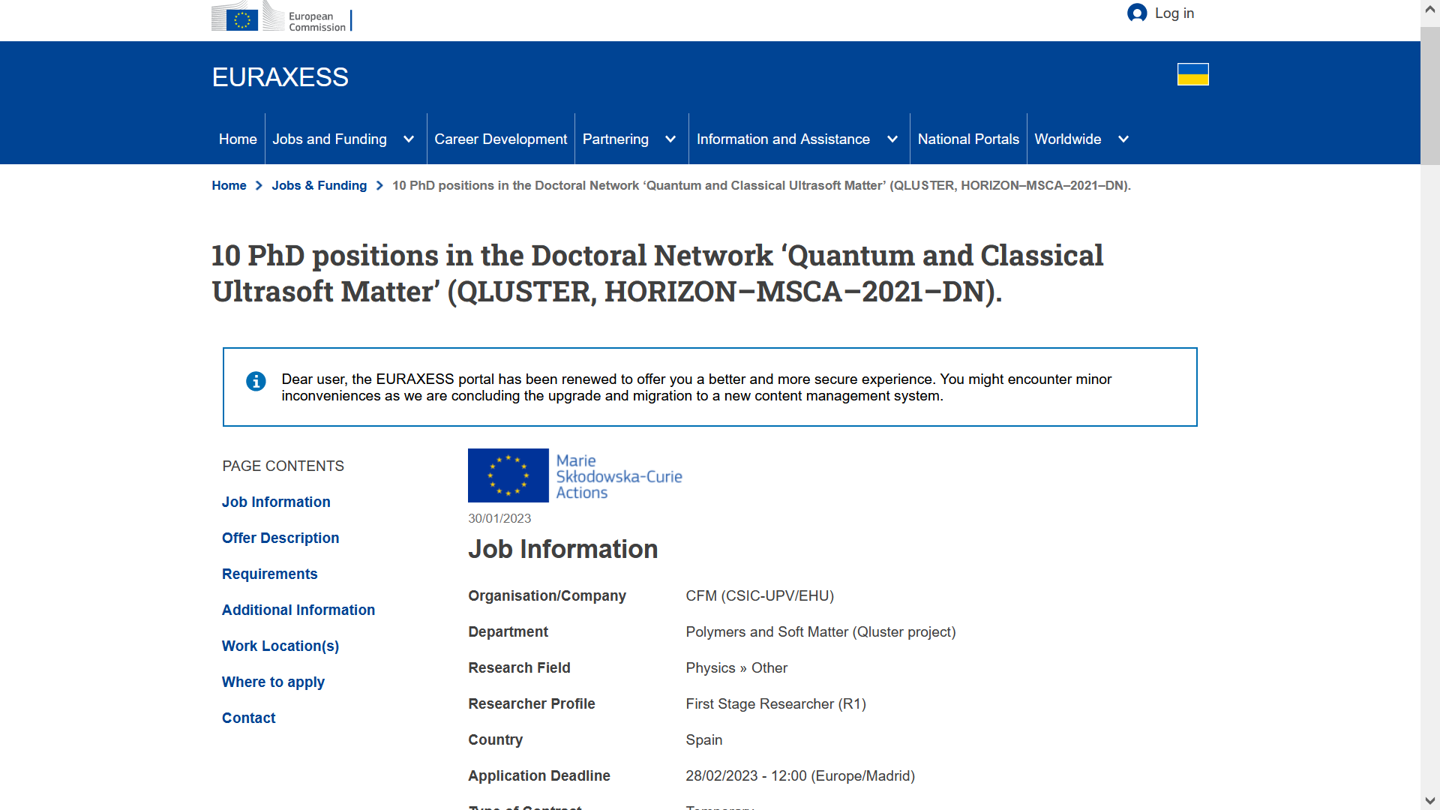
Vacancies – PhD position
DN vacancies have to be published on the EURAXESS portal: https://euraxess.ec.europa.eu/jobs
Notes:
On this slide you see a typical PhD position offered in the framework of MSCA DN:
All necessary information such as a comprehensive description of the position, the application deadline and the contact information for your application is available.
You apply for this position directly with the host.

Slide 28
DN: Panels
Applications are submitted & evaluated in eight scientific panels:
Chemistry (CHE)
Social Sciences and Humanities (SOC)
Economic Sciences (ECO)
Information Science and Engineering (ENG)
Environment and Geosciences (ENV)
Life Sciences (LIF)
Mathematics (MAT)
Physics (PHY)

Slide 29
DN: Evaluation Criteria
Excellence (50%)
Impact (30%)
Quality and efficiency of the implementation (20%)
Proposals submitted to the previous call of MSCA Doctoral Networks under Horizon Europe and having received a score of less than 80% should not be resubmitted the following year

Slide 30
DN Call 2023
Call 2021: 1076 proposals, 144 projects funded, budget: 405 Mio. €
Success rate: 13.4 %
Open | Budget | Deadline
30. May 2023 | 434.8 Mio. € | 28. November 2023
Notes:
Tentative dates!

Slide 31
MSCA job search & career development support via EURAXESS
HORIZON EUROPE

Slide 32
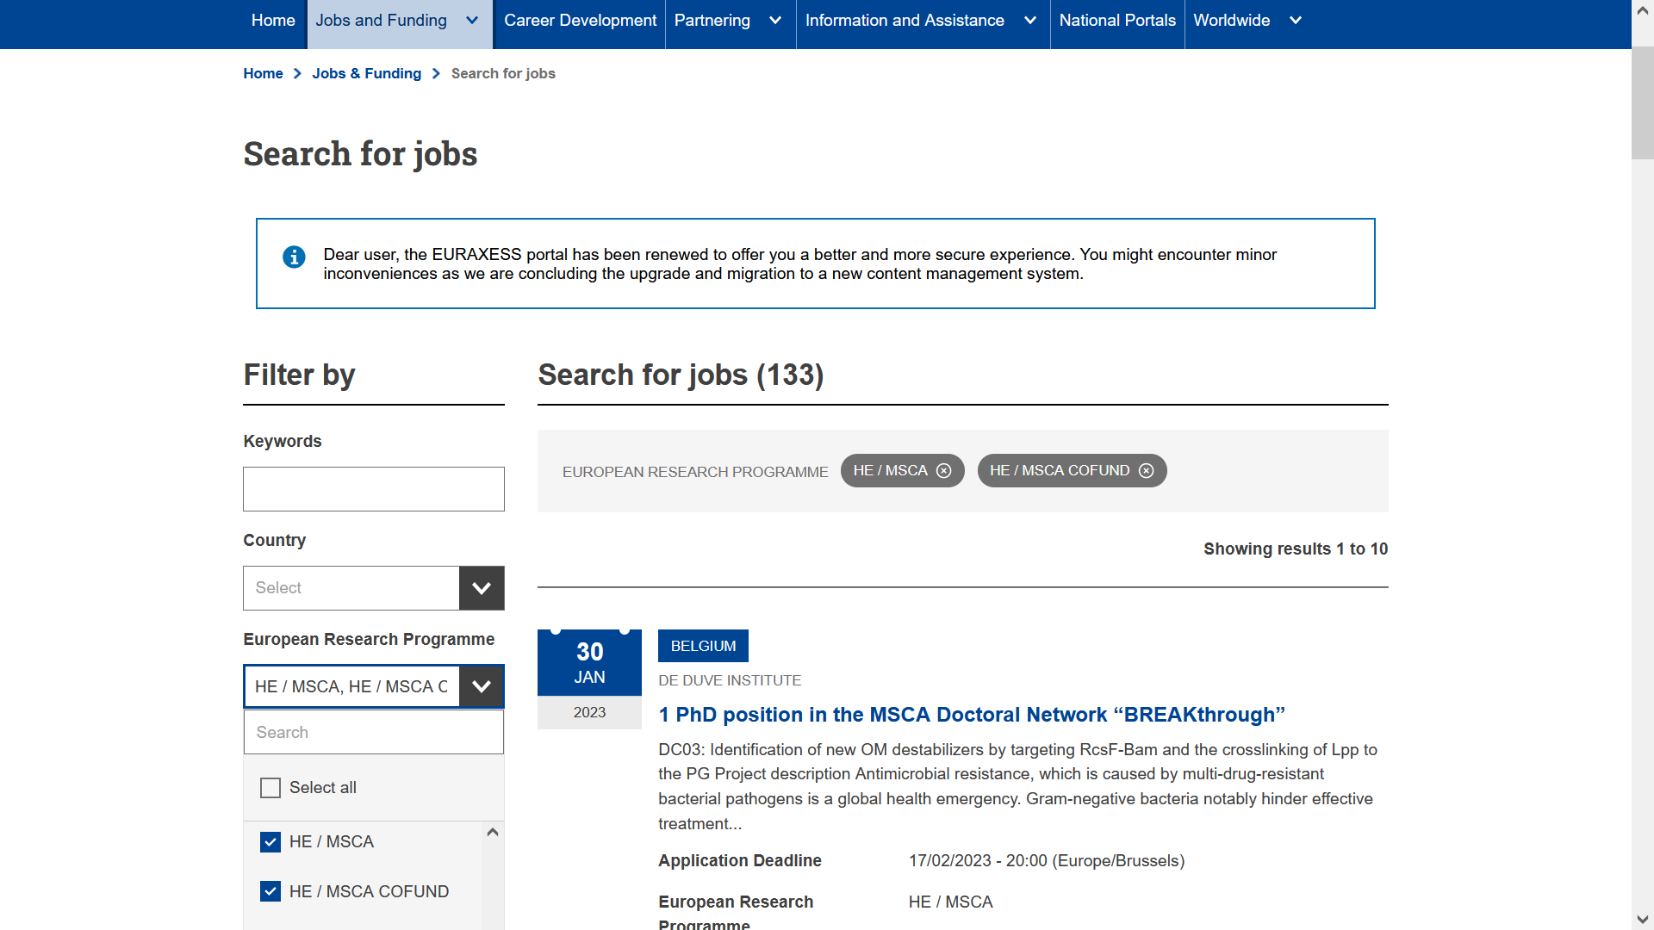
MSCA Jobs: https://euraxess.ec.europa.eu/jobs/search

Slide 33
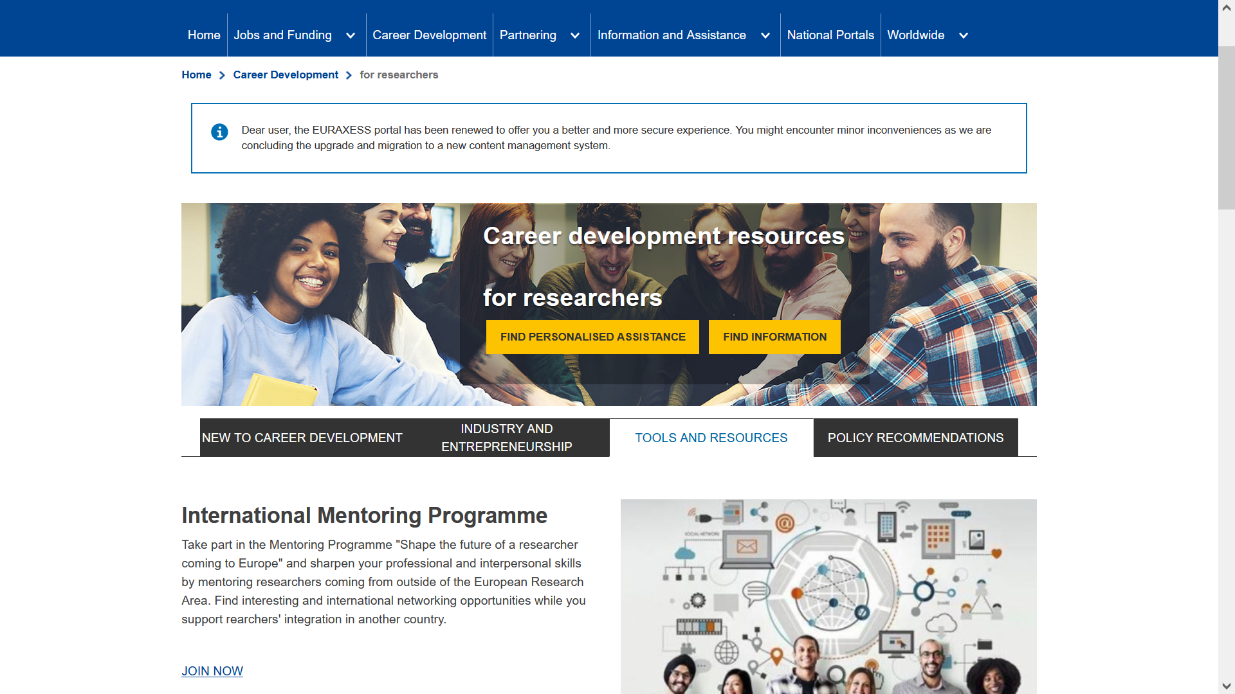
Career Development resources for researchers at EURAXESS
https://euraxess.ec.europa.eu/career-development/researchers

